Slide 1
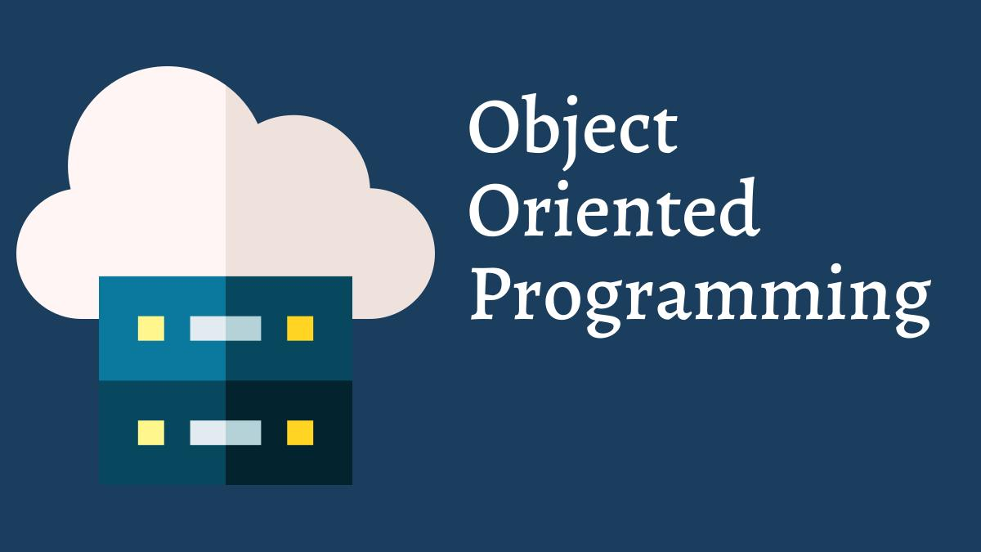
Presented by :
Murat, Olena, Yusuf, Ari

Slide 2
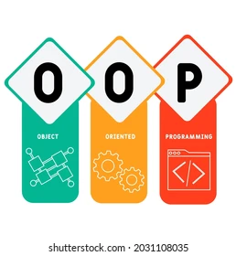
CONTENT
HISTORY
STRUCTURE
OOP PRINCIPLES
BENEFITS
OOP LANGUAGES
LIVE DEMO
Q & A

Slide 3
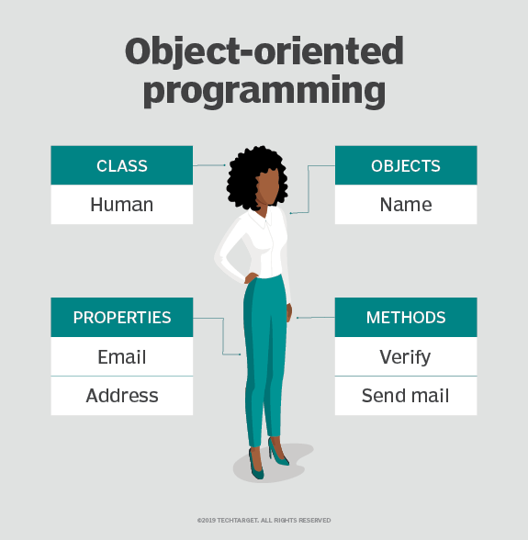
WHAT IS OBJECT ORIENTED PROGRAMMING ?
SIMPLE
REUSABLE CODE BLOCKS
Notes:
brief overview of what you can achieve with OOP: you can use it to structure a software program into simple, reusable code blocks (in this case usually called classes), which you then use to create individual instances of the objects.

Slide 4
HISTORY
Python, Ruby, C#, VB.NET have emerged that are primarily object-oriented, but that are also compatible with procedural methodology
Smalltalk and OOP to a wider audience being introduced - Adele Goldberg
LISP - Alan Kay
Sketchpad - Ivan Sutherland
Simula
1960s
1980s
Present
1970s
1990s
1st version of the Smalltalk - Xerox PARC (ALan Kay, Dan Ingalls, Adele Goldberg)
Object-oriented programming developed as the dominant programming paradigm

Slide 5



STRUCTURE of OOP —> How would you run a petshop?
You have to keep many data:
And to be able to operate this data!
We can write code for each item, and operate them separately - huge and long code!
And there many brands and diverse types of each product …

Slide 6
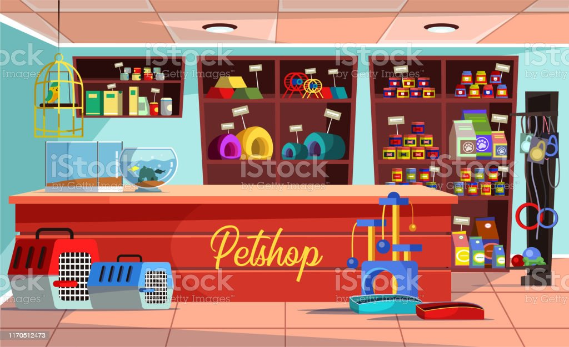
OR
We can group related information together to produce shorter and more reusable code!

Slide 7
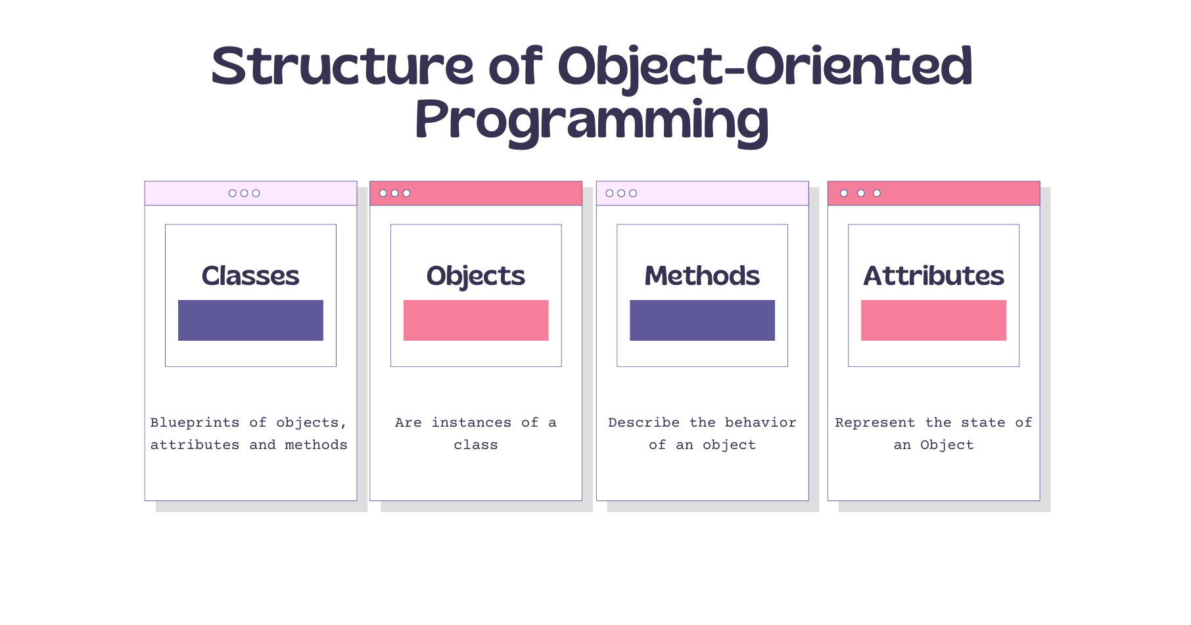
Notes:
Classes - these are user-defined data types that act as the blueprint for objects, attributes, and methods.
Objects - These are instances of a class with specifically defined data. When a class is defined initially, the description is the only object that is defined.
Methods - These are functions that are defined inside a class that describe the behavior of an object. They are useful for reusability or keeping functionality encapsulated inside one object at a time. Code reusability is a great benefit when debugging.
Attributes - These are defined in the class template and represent the state of an object. Objects contain data stored in the attribute field.

Slide 8

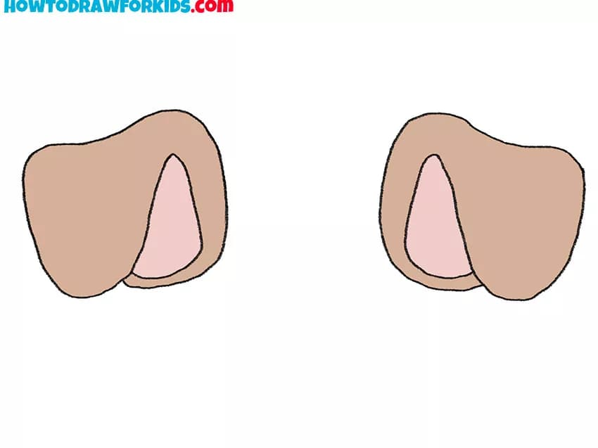

At first we need to create a class
A class is like a set of instructions.
It describes the methods (functions)
and properties (variables)
that will exist in an object
when it's created.
2. Class template contains attributes which represent the state of an object
Notes:
Before we can build an object however we need to create a class -- or the blueprint from which that object is constructed by the computer. A class is like a set of instructions that tells the computer how to create your object in memory. A class describes the methods (functions) and properties (variables) that will exist in an object when it's created.
The class allows many objects to be created from a single definition just as a factory can produce many cars from a single set of designs. At the same time each object can store unique values associated with it just as each car from a factory can have different options (for example, its color, number of doors, and other features).

Slide 9
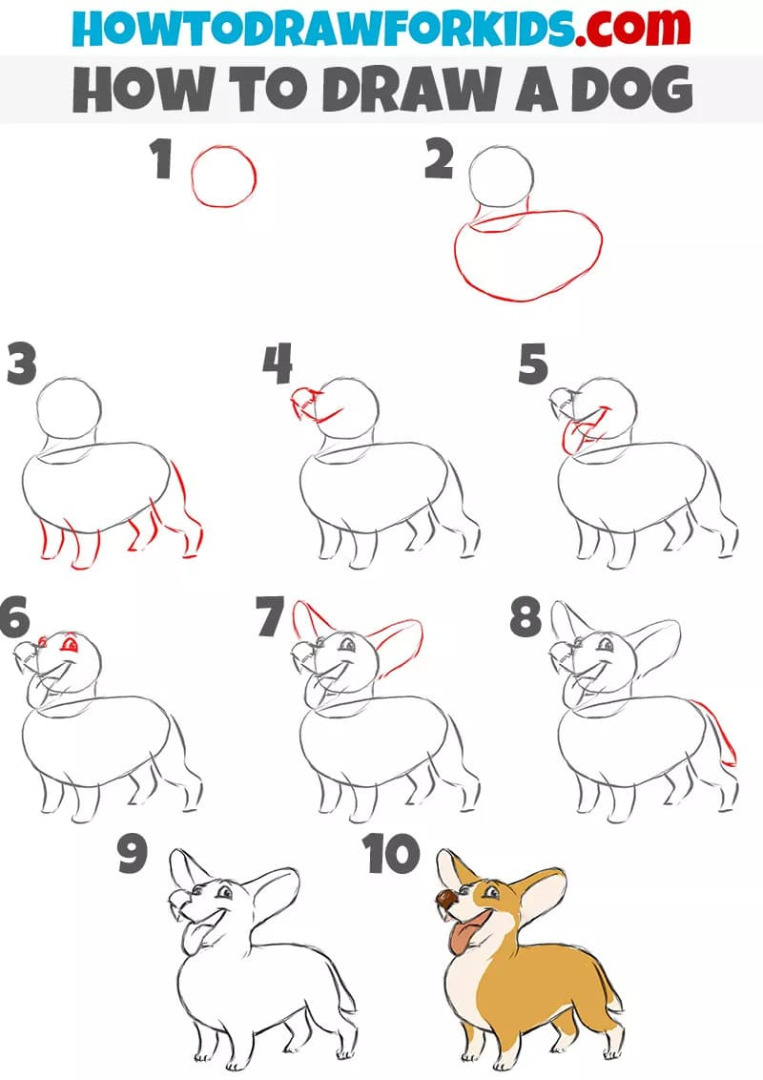
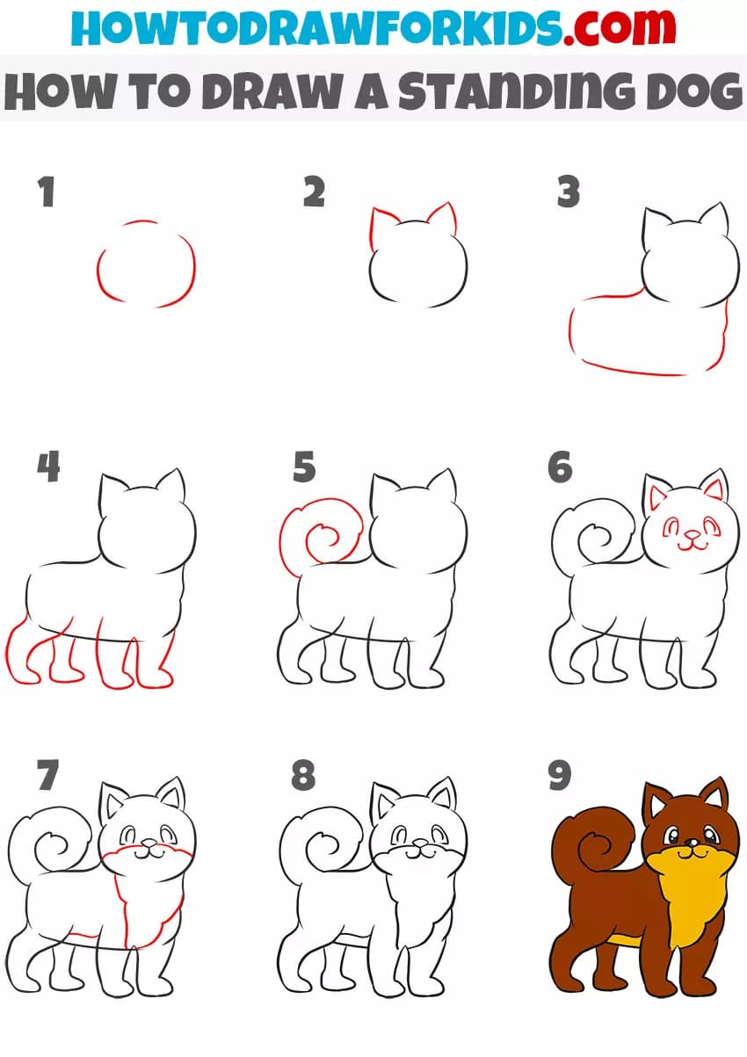
3. Many objects with unique values can be created from a single definition
Same properties (already exist in the class constructor)
gain unique values result in unique objects.

Slide 10
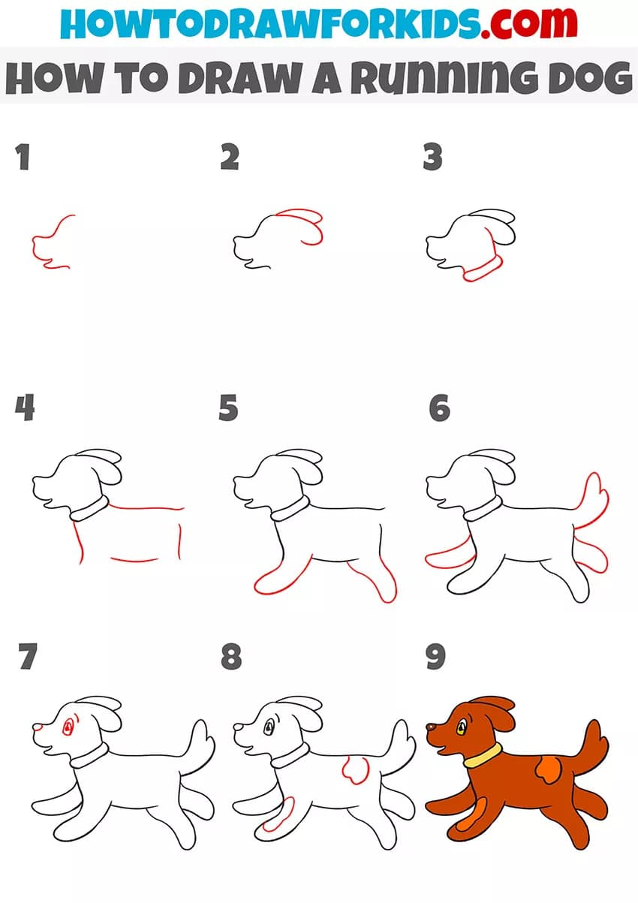
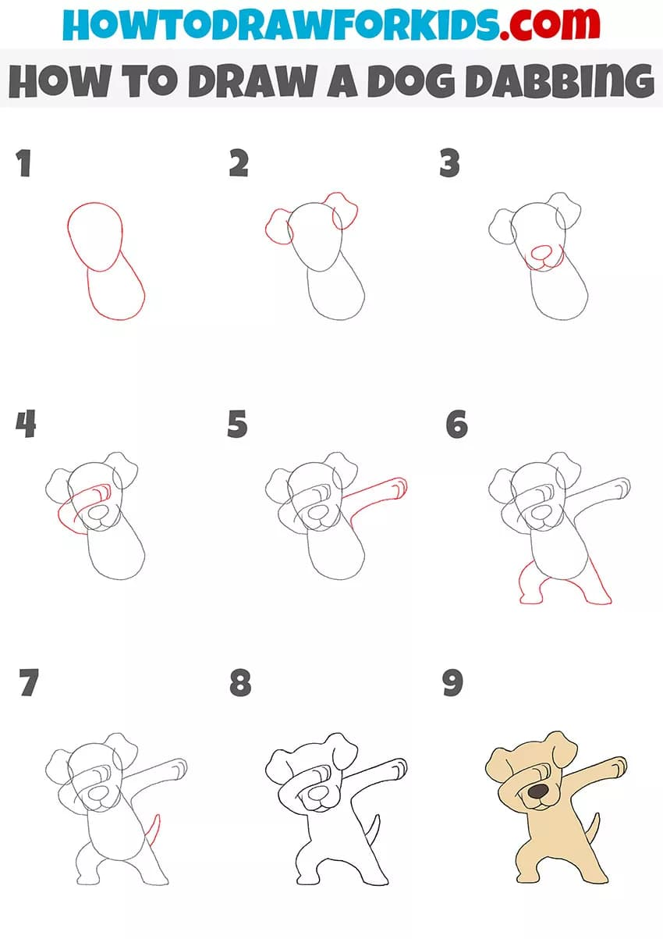
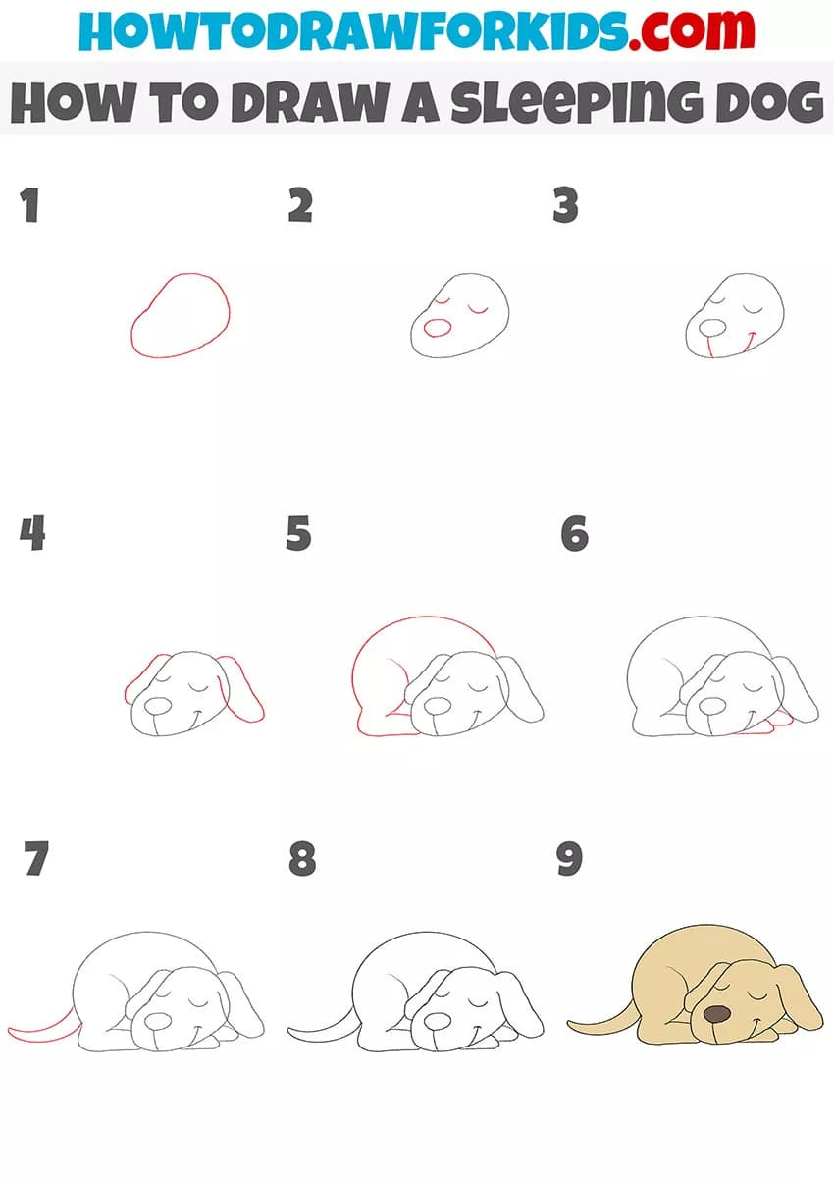
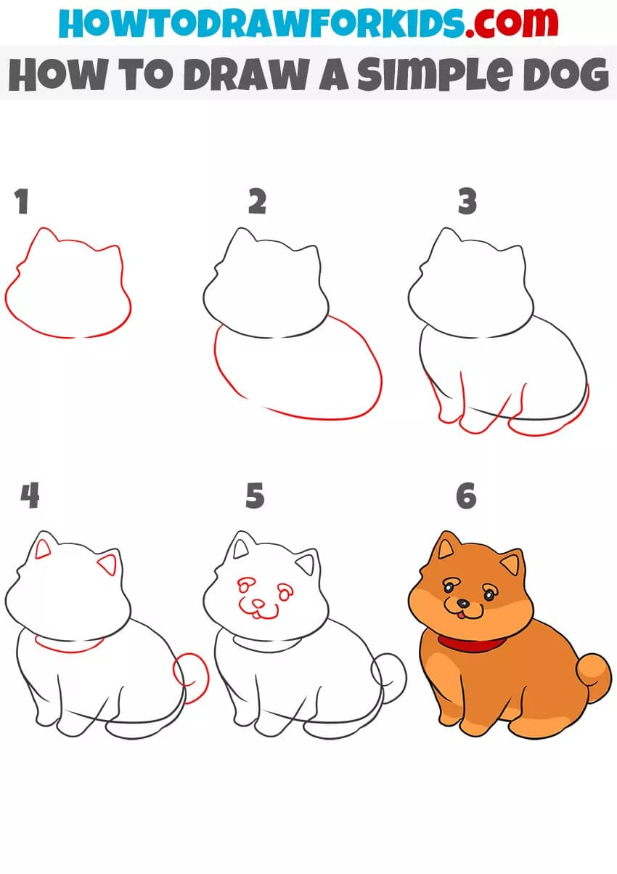
4. Methods are functions that are defined inside a class that describe the behavior of an object.
Different objects with different behavior The same objects with different behavior

Slide 11
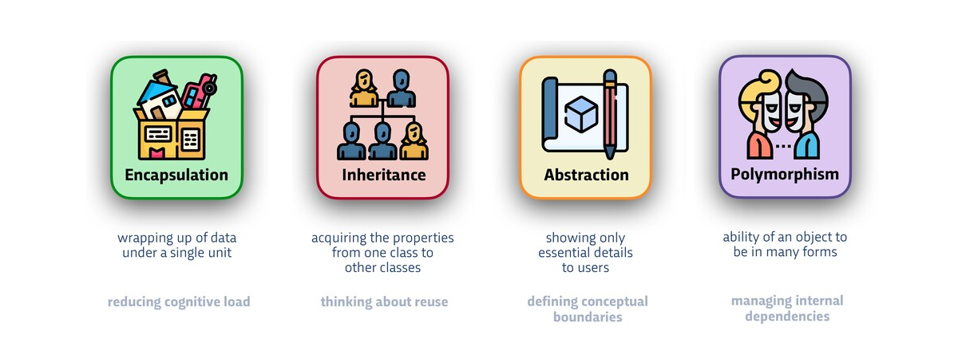
OOP PRINCIPLES

Slide 12
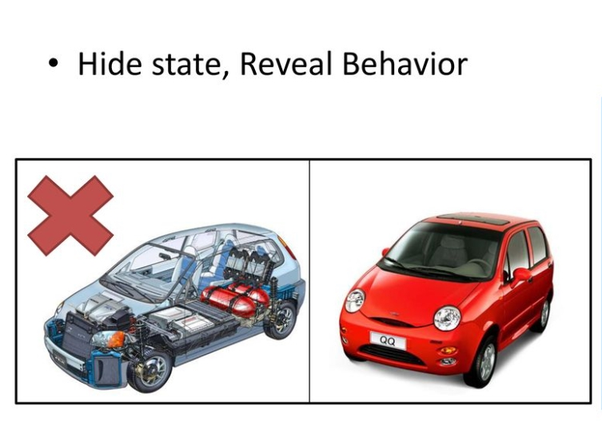
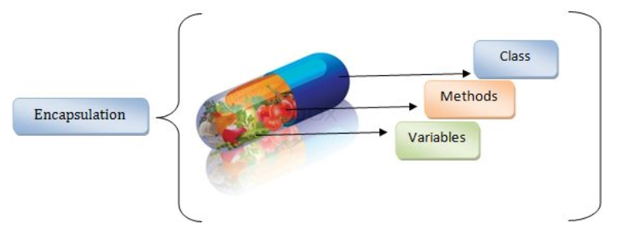
ENCAPSULATION
Each object is privately held inside a class.
Other objects do not have access to this class.
Only able to call a list of public functions or methods.
This provides greater program security and avoids unintended data corruption.

Slide 13
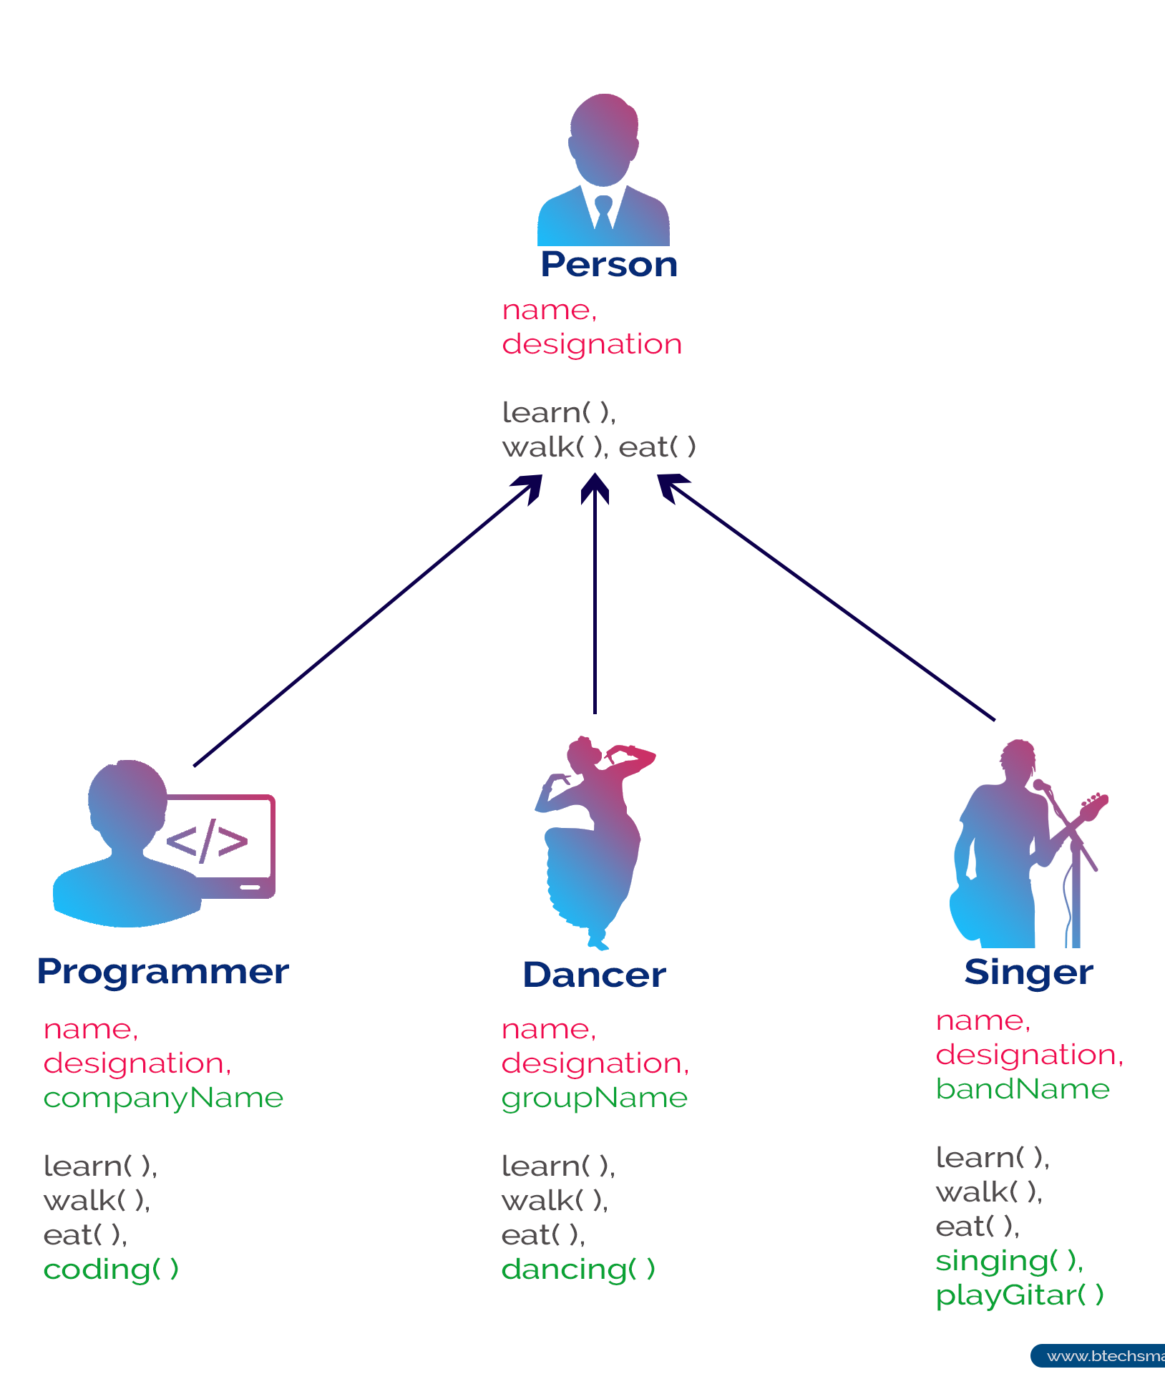
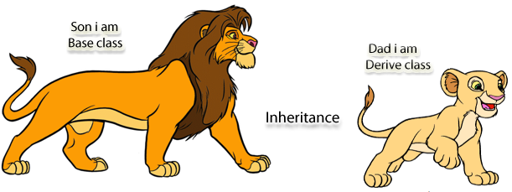
INHERITANCE
Inheritance allows classes to inherit features of other classes.
This property forces a more thorough data analysis.
Inheritance reduces development time
That ensures a higher level of accuracy.

Slide 14

INHERITANCE

Slide 15
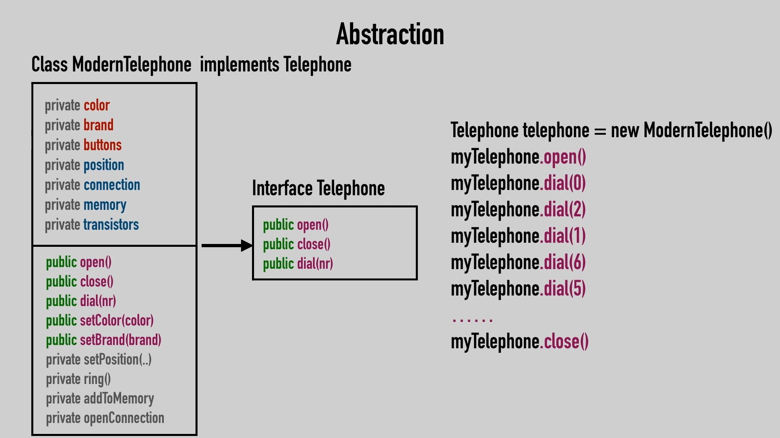
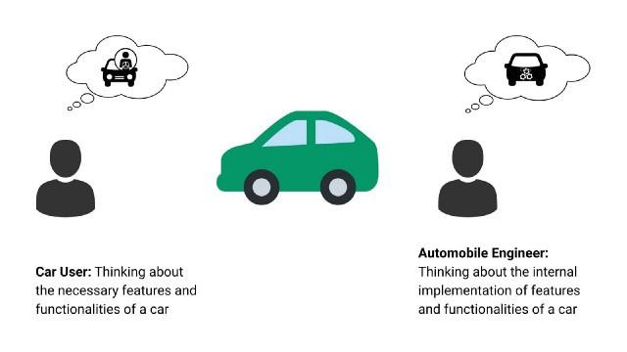
ABSTRACTION
Abstraction is used to handle complexity by allowing to see only relevant and useful information (simplify).
Hiding the inner details from the outside world.
Know what it does, not how it does it.

Slide 16

ABSTRACTION

Slide 17
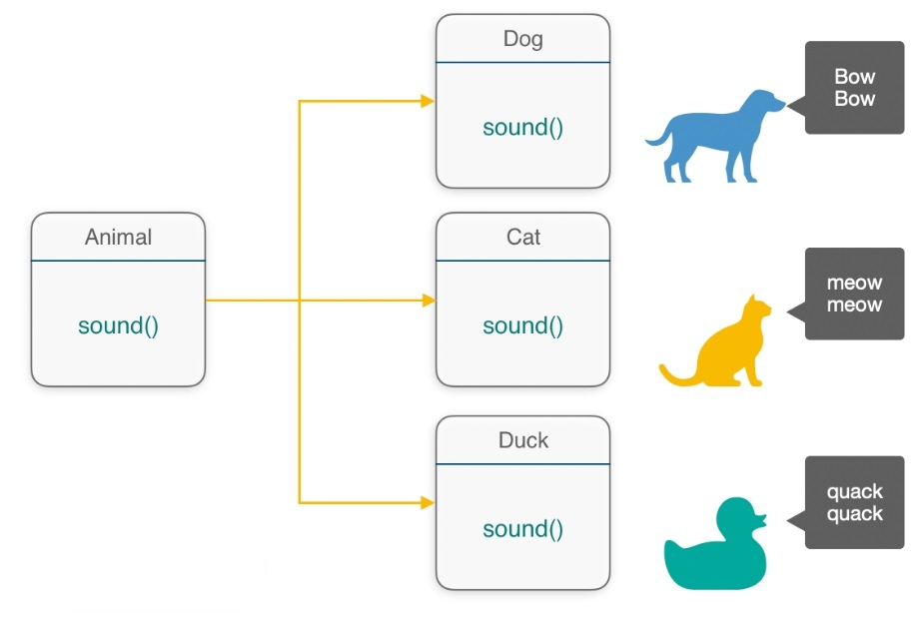
POLYMORPHISM
Methods produce different outputs or do different jobs depending on the object.
It is to give methods flexibility to behave polymorphously (instead of fixed tasks).
The verb "to play" is used for all musical instruments but a piano is played differently from a cello

Slide 18

POLYMORPHISM

Slide 19
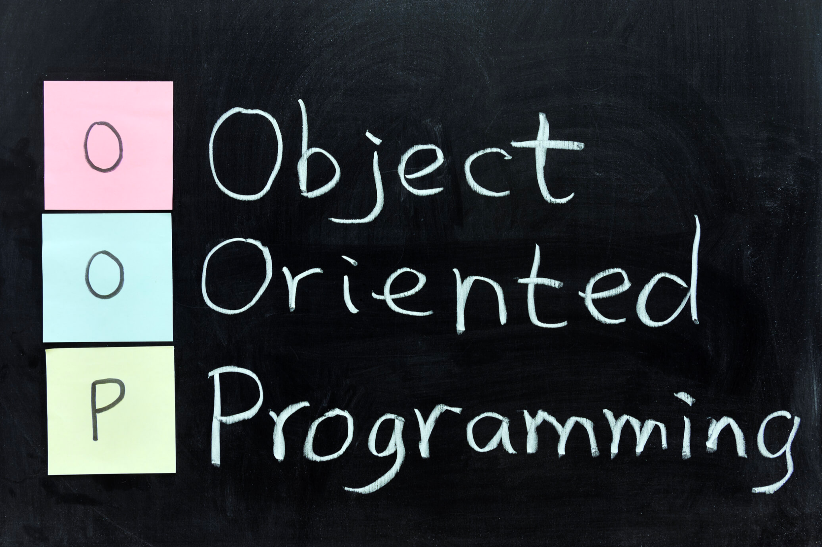
BENEFITS
of the

Slide 20
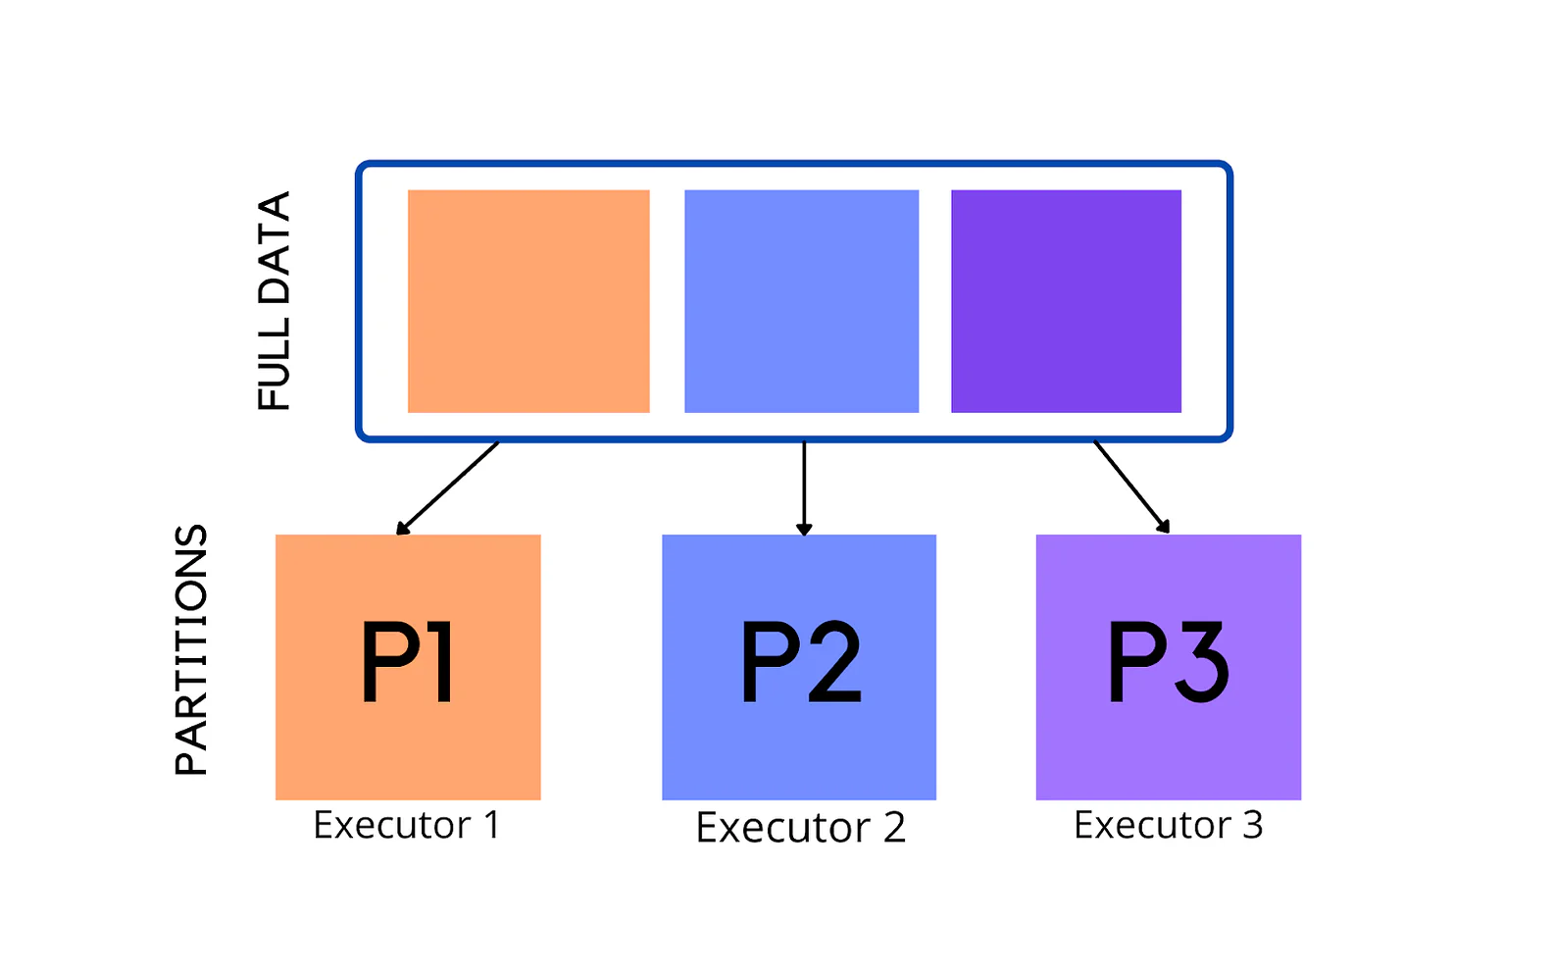
SIMPLICITY
Easy to partition the work in a project based on objects

Slide 21
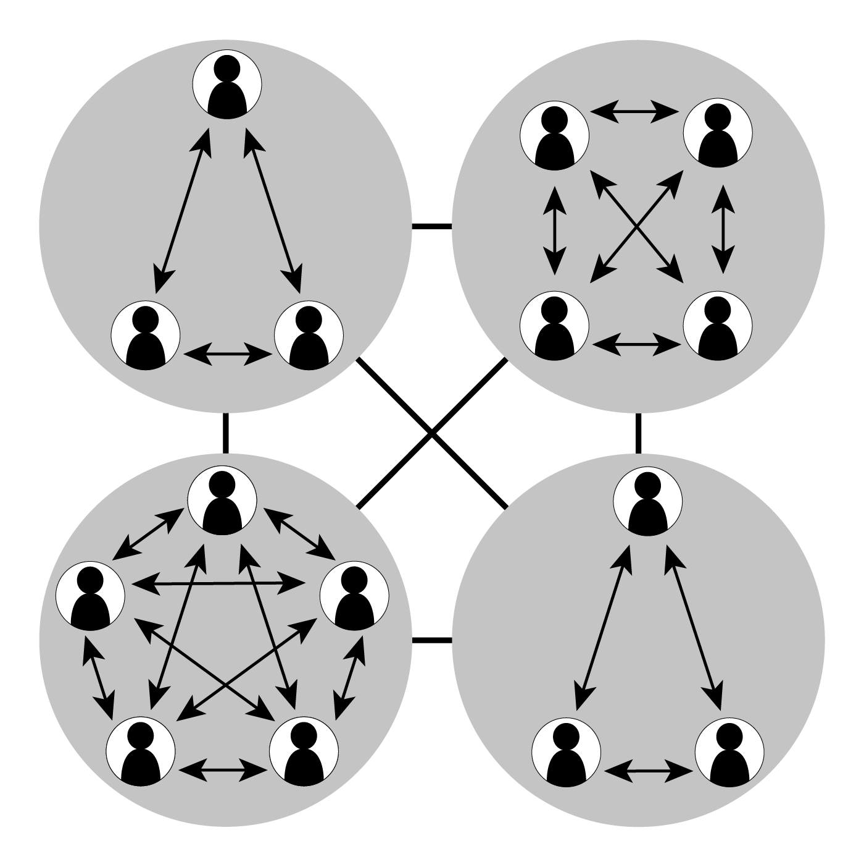
MODULARITY
Building programs from standard working modules that communicate with one another

Slide 22

MODIFIABILITY
Easy to make minor changes

Slide 23

RE-USABILITY
Objects can be reused in different programs

Slide 24
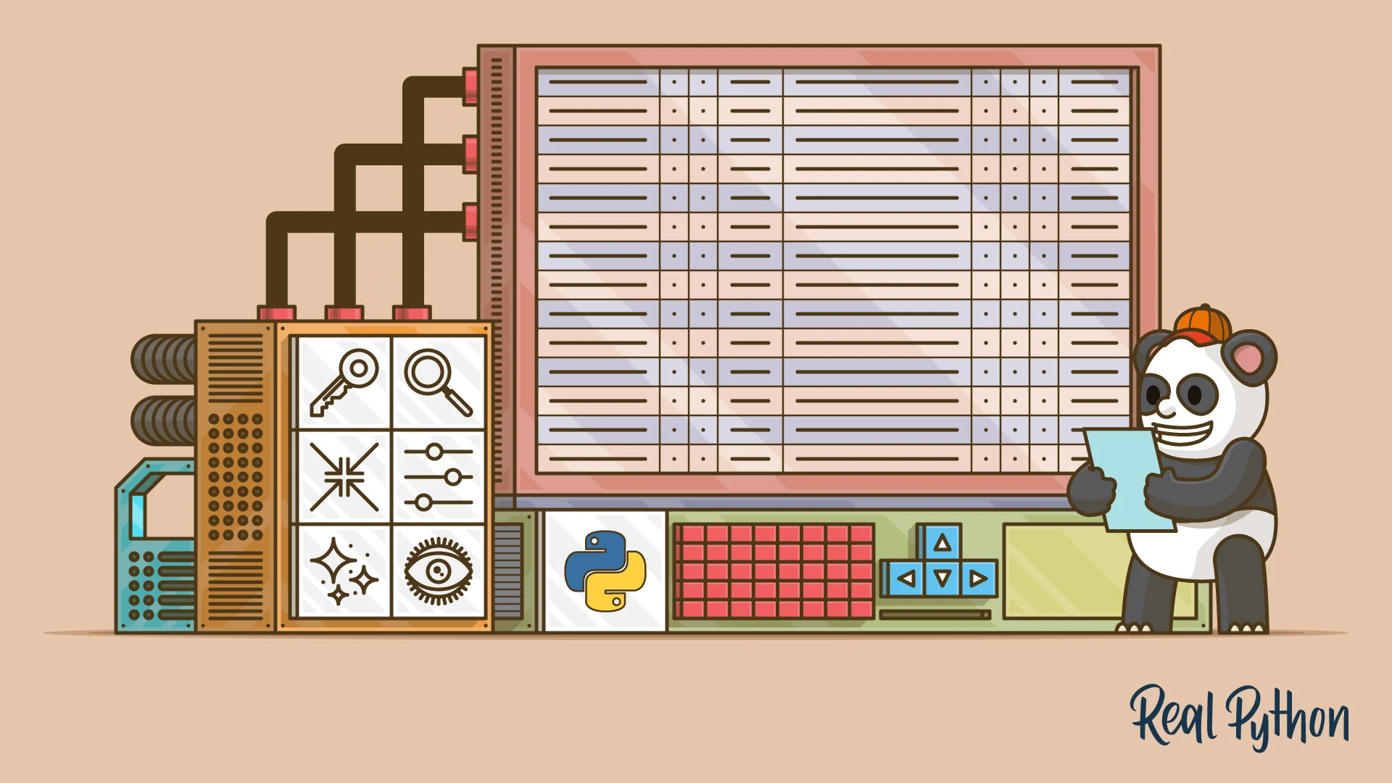
INHERITANCE
Eliminates redundant code and extends the use of existing classes

Slide 25

ABSTRACTION
Helps programmer to build secure program

Slide 26
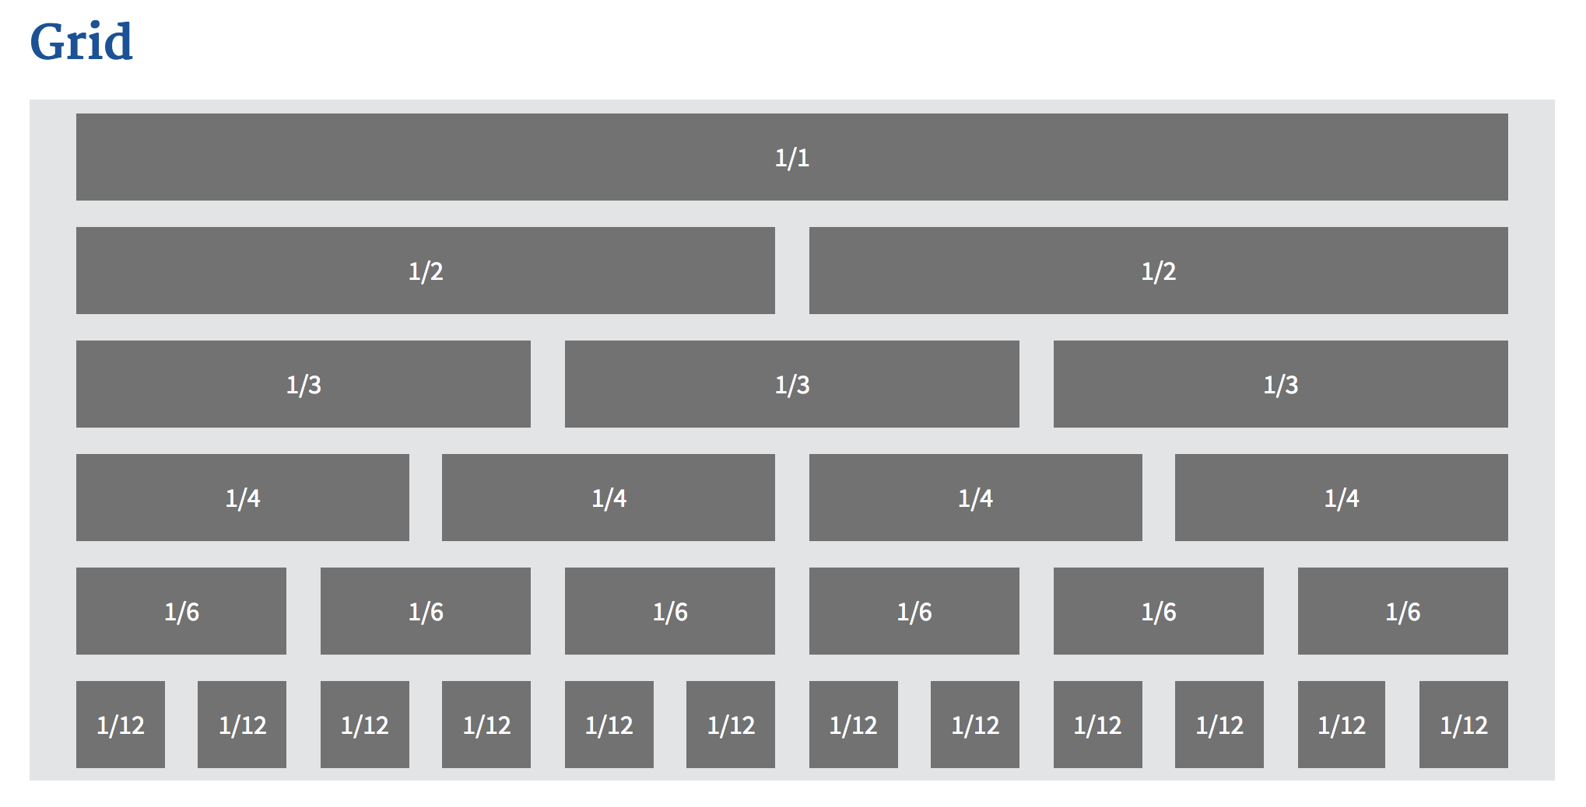
UPGRADATION
Can be upgraded from small to large system

Slide 27

LOWER COST of DEVELOPMENT
Reuse of software lowers the cost of the development

Slide 28
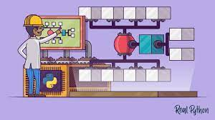
MAINTAINABILITY
Objects can be maintained separately

Slide 29
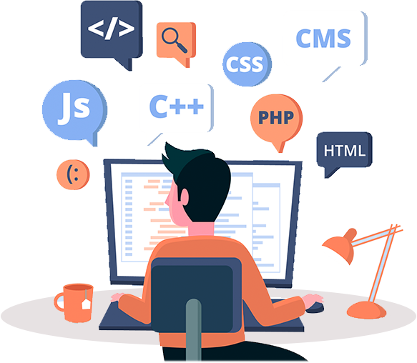
OOP LANGUAGES
High Level
More human readable
Require translation by compiler
Based on four principles
Encapsulation
Abstraction
Inheritance
Polymorphism.
Notes:
Examples of OOP langs:
Scala
Emerald
Ruby
JADE
Java
Python
C++
JavaScript
Visual Basic .NET
PHP
And many more.

Slide 30
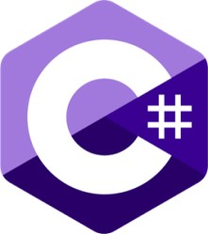





Slide 32
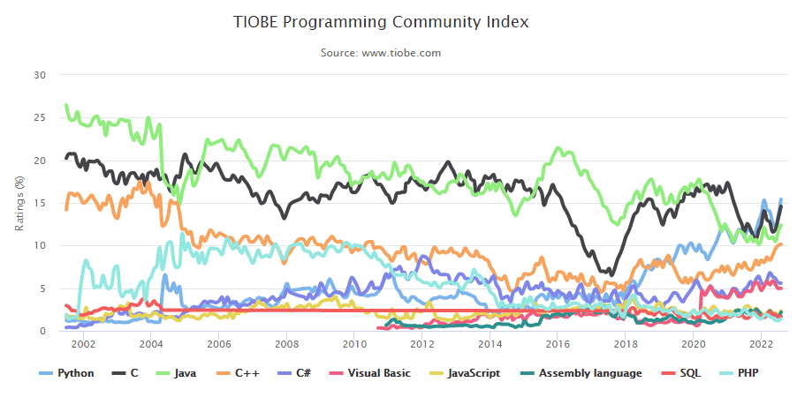
Notes:
The TIOBE (The Importance of Being Earnest) programming language popularity index graph from 2002 to 2018. In the 2000s the object-oriented Java (green) and the procedural C (black) competed for the top position.

Slide 33

LIVE DEMO

Slide 34


Slide 35


